Slide 1
CMSC 304
Data Types & Type Checking
Claire Sparks

Slide 2
Data Types Introduction
Every program uses data, either explicitly or implicitly, to arrive at a result
Data in its most primitive form is simply a collection of bits
Hardware can interpret bits in several different ways:
  instructions, addresses, characters, integer and floating-point numbers
The bits themselves, however, are untyped: the hardware makes no attempt to keep track of which interpretations correspond to which locations in memory
This does not provide the kinds of abstraction necessary for large programs

Slide 3
Data Types Introduction
Most programming languages include a notion of type for several reasons:
  Types provide implicit context for many operations, so that the programmer does not have to specify that context explicitly
    For example, In C, the expression a + b will use integer addition or floating-point addition
  Types limit the set of operations that may be performed in a semantically valid program
    For example, prevent the addition a character and an array
  Explicitly specified types often make a program easier to read and understand
  If types are known at translation time they can be used to drive important performance optimizations

Slide 4
Type Nomenclature in Sample Languages
High-level languages almost always associate values with type, to provide contextual information and for error checking
A type name represents the possible values that a variable of that type can hold and the way those values are represented internally
Various language definitions use different and confusing terminology to define similar things
What follows is a brief description of the type differences among four languages: C, Java, Python, and Ada
Notes:
Taking different approaches to analyze data types from. These definitions are retrofitted.
These lenses come second.
This is exactly like the language paradigms, remember that they came after as labels designed by academics,
so there is overlap

Slide 5
C
C has two categories of data types:
  Basic types
    void
    Numeric types:
      Integers (12 possible kinds)
        Integer types can be signed or unsigned
      Real numbers (3 possible kinds)
    No Boolean type!
      In C, 0 represents false and all other numeric values represent true
  Derived types
    Combine existing types into a new data type
      i.e. they are derived from other data types
      Also referred to as compound data types
Notes:
1972… old school language (12 types of integers, 3 types of floating point)

Slide 6
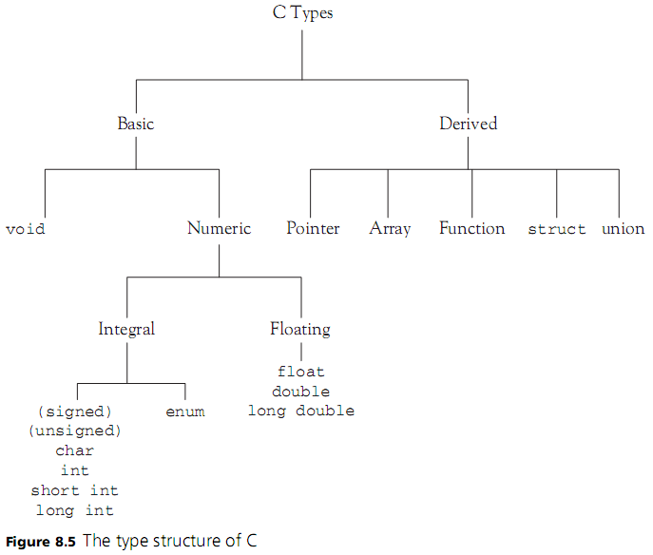
C
Notes:
no Boolean and char is an integral number!

Slide 7
Java
Primitive types:
  Boolean (not numeric)
  Numeric:
    Integral
    Floating point
Reference types: constructed using type constructors
  Array
  Class
  Interface

Slide 8
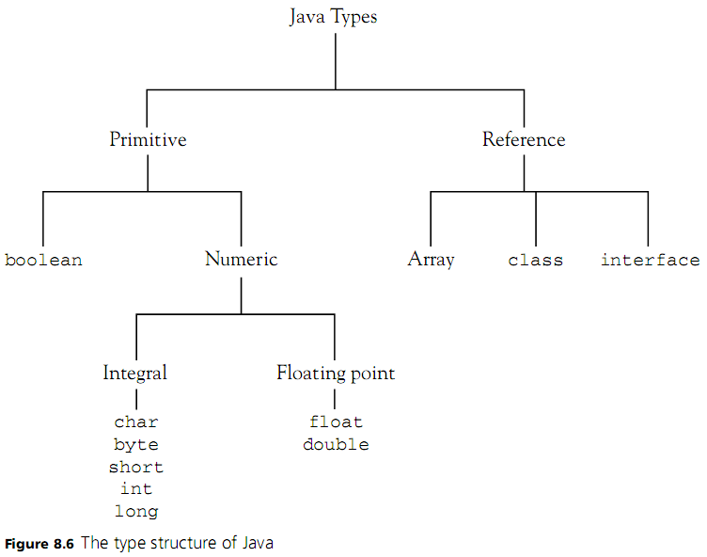
Java

Slide 9
C vs. Java
Notes:
Similar, but even small changes have large impacts!
Booleans no longer double dip
in c function can return a double dip, e.g. truthiness vs. numeric result.
Could be beneficial in that you have a double return for one value
Assignment operator in both C and Java actually return something, but doesn't come up very much.
Java compile error, C it's perfectly fine

Slide 10
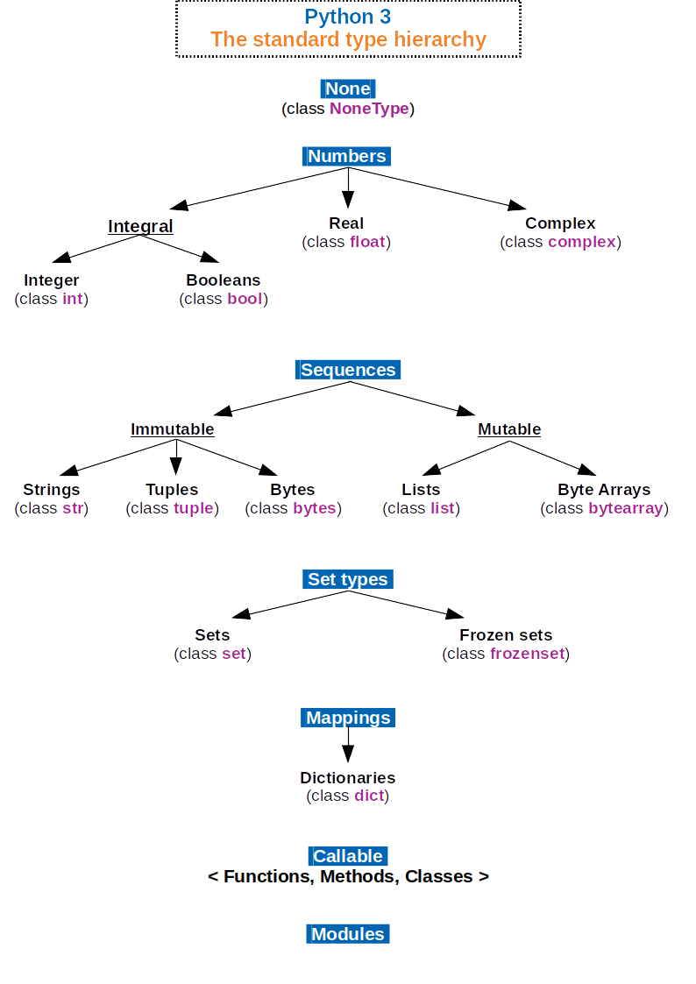
Python Data Types
All data types are objects
Python has several built-in data types:
None
  Python equivalent of null
Numeric types:
  int: Integers; non-limited length
  bool: True / False
  float: Floating-Point numbers, equivalent to Java doubles
  complex: Complex numbers
Notes:
All these built in data types are objects
Contrast this with Java’s messy Primitive vs Reference type nonsense

Slide 11
Ada
Ada has a rich set of types
  Scalar types
  Discrete types
  Numeric types include real and integer types
  Pointer types are called access types
  Array and record types are called composite types

Slide 12
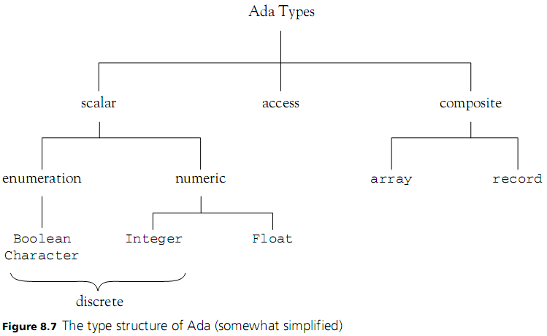
Ada
Notes:
Same principles for types, but can have wildly different outcomes

Slide 13
Type Checking
Type checking: the process by which a translator verifies and enforces that data types are being used correctly
  For example: if a function call requires a single argument of type int, type checking confirms the given value is actually an integer value
  Type checking is done by the translator during scope analysis
Vital for preventing inaccurate results during program execution
What happens if types aren’t checked?
  Computer must assume that data it’s given is always the correct type of data
  If it isn’t, the computer will incorrectly interpret the data (!!!)
  Super unsafe! Can cause pseudo-random errors which are hard to debug
  The BCPL language has no type checking at all
All modern languages have some form of type checking
Notes:
We take this for granted instead of like a guardrail/seatbelts. Seatbelts weren't standard in cars till 1968!!!
don't need to state how to interpret bits nor what context.
Late 50's early 60s, we didn’t have this luxury.
BCPL, no data types, you'd specify how to treat specific variables at time of operation.
Huge lack of security!
increases readability.
Implicit typing exists. Python crashes, BCPL just interprets it different.

Slide 14
Type Checking
Two types of type checking:
  Static: types are determined from the text of the program and checked by the translator
  Dynamic: type information is maintained and checked at runtime
We can think of type checking as a safety feature
In a statically typed language, type errors can be caught before runtime
  Type errors are reported as compilation error messages that prevent execution
  Traditionally requires programmer to specify the type of data in each variable
  Java is a statically typed language

Slide 15
Type Checking
In a dynamically typed language, type errors are caught at runtime
  No types in variable declarations and no explicit type names
  Objects themselves are the only constructs with type information
  Type errors cause program termination
    Type checking at runtime is throwing an exception rather than attempting the operation
  Python is a dynamically typed language
To preform type checking a translator applies a type equivalence algorithm to all expressions and statements
  May vary type of equivalence algorithm to suit the context
  We’ll circle back to type equivalence algorithms in a bit

Slide 16
Type Checking
Strongly typed: a language that specifies a statically applied type system that guarantees all data-corrupting errors will be detected at the earliest possible point
  Most errors are detected at translation time
  All unsafe programs are rejected
    Either at translation time or before executing data-corrupting actions
    Unsafe programs: programs with data-corrupting errors
  Can also reject safe programs due to strict type rules
Weakly-typed language: one that has type system loopholes that may allow unsafe programs
Notes:
Smalltalk, Perl, Ruby, Python, and Self and Lisp

Slide 17
Type Checking
Static and dynamic typing are discrete categories with clear differentiation between the two
Strong and weak typing are two ends of a spectrum with poor differentiation
C is statically typed because types are determined from the text of the program and checked by the compiler
But a programmer can subvert this type system with ease
  By making all data types void pointers for example
Would we classify C as a strongly typed or a weakly typed language?
Trying to assert a language is strongly or weakly typed in absolute terms is a bad (yet common) idea

Slide 18
Type Checking
In a statically typed language, type errors can be caught before runtime
  Type errors are reported as compilation error messages that prevent execution
A language definition may not specify whether dynamic or static typing is used
C compilers apply static type checking during translation, but C is not very strongly typed since many inconsistencies do not cause compilation errors
C++ adds stronger type checking, but mainly in the form of compiler warnings rather than errors, which do not prevent execution

Slide 19
Type Checking
Ada is an overall strongly typed language
All type errors cause compilation error messages
  Certain errors, like range errors in array subscripting, cannot be caught prior to execution
  Such errors cause exceptions that will cause program termination if not handled by the program

Slide 20
Type Checking
Reasons to have some form of static type-checking:
  Execution efficiency: allows compilers to allocate memory efficiently
  Translation efficiency: static types allow the compiler to reduce the amount of code to be compiled
  Writability: allows many common programming errors to be caught early
  Security and reliability: reduces the number of execution errors

Slide 21
Type Checking
Reasons to have some form of static type-checking, cont.:
  Readability: explicit types help to document data design
  Remove ambiguities: explicit types can be used to resolve overloading
  Design tool: explicit types highlight design errors and show up as translation-time errors
  Interface consistency and correctness: explicit data types help in verification of large programs

Slide 22
Implicit Types
Implicit types: types that are not explicitly given in a declaration
  The type must be inferred by the translator, either from context information or from standard rules
In C, variables are implicitly integers if no type is given, and functions implicitly return an integer value if no return type is given
  x; // implicitly an int
Literals are the major example of implicitly typed entities
Notes:
fortran letters i,j,k,l, and m are implicitly integers

Slide 23
Type Inference
Type inference: types of expressions are inferred from the types of their subexpressions
  Is an essential part of type checking
Type-checking rules and type inference rules are often intermingled
  They also have a close interaction with the type equivalence algorithm
Type inference and type checking rules are one of the most complex parts of programming languages
Hard to avoid nonorthogonalities
Notes:
Orthogonal design allows language constructs to be combined in any meaningful way with no unexpected restrictions or behaviors arising as a result of the interaction of the constructs
Constructs can be combined in any meaningful way, with no unexpected restrictions or behaviors
Constructs should behave the same when used in different contexts

Slide 24
Type Conversion
Type conversion: converting from one type to another
  Can be built into the type system to happen automatically
Implicit conversion (or coercion): inserted by the translator
  i.e. in Java:
  3 + 5.7
  Where 3 is implicitly converted to a double
Widening conversion: target data type can hold all of the converted data without loss of data
Narrowing conversion: conversion may involve a loss of data

Slide 25
Type Conversion
Implicit conversion:
  Can weaken type checking so that errors may not be caught
  Can cause unexpected behavior if the conversion is done in a different way than the programmer expects
Explicit conversion: conversion directives are written into the code
  Conversions are documented in the code
  Less likelihood of unexpected behavior
  Makes it easier for the translator to resolve overloading

Slide 26

Type Conversion
Example In C++:
  Ambiguous, because of the possible implicit conversions from int to double on either first or second parameter
Java only permits widening implicit conversions for arithmetic types
C++ emits warning messages for narrowing
Notes:
Ambiguous means compile error in this context

Slide 27
Type Conversion
When preforming type conversion, is the underlying binary data converted from one data type into another? Or is that data merely reinterpreted as another data type?
  This is a vital distinction to make
For this course, we will define type conversion as:
  Converting the underlying data from one data type into another
We will define casting as:
  Reinterpreting the underlying data as another data type without modifying the underlying bits
Please note in common usage the definition of these terms are much more muddled
  We'll use these explicit and distinct definitions to reduce ambiguity
Notes:
Casting is converting data, the interpretation of the underlying bits.
For structured types, could be allowable, a lot of languages don't. So you need some structural equivalence. A cast can't simply just work.
They are very uncommon.
Object oriented is different, because we're just casting "references" not the actual bits. Java will crash if the cast doesn't work.

Slide 28
Casting
Casts are most commonly used in object-oriented languages to allow flexibility in the typing system
  Casting a variable of type superclass to type subclass reinterprets the object referenced by superclass variable as an object of type subclass
  If the underlying object is of type subclass, re-interpreting it’s bits does not cause any errors
  If it’s not, re-interpreting the objects bits as that of another object causes a runtime error
A similar use of casts is casting pointers
  As a pointer is just a location in memory, the data type associated with a pointer variable refers to the type of the data pointed to, not the pointer itself
    The pointer always stores a hexadecimal number, i.e. a memory address
  Casting pointers allows flexibility in the typing system

Slide 29
Casting
Casting as we have defined it is used exclusively to increase the flexibility of a languages typing system
It does this by allowing a variable of type X to be interpreted as type Y
  If the underlying data can’t be interpreted in this way, the cast fails and the program crashes
But what about a dynamically typed language where variables are not associated with data types?
Casting (as we have defined it) has no purpose in a dynamically typed language
  The restrictions casting subverts aren’t present in a dynamically typed language at all!

Slide 30
Type Conversion
To complicate matters, some languages use the syntax and terminology of casting to describe converting between arithmetic types
  Historical reasons for this, including typing systems which define several different integer types which are identical outside of their size (i.e. C)
  For our purposes, we will consider transforming one arithmetic type into another as a type conversion, regardless of the syntax / terminology used
Otherwise, the most common approach to perform type conversions is to use predefined or library functions
  Ada uses attribute functions to allow conversions between characters and their ASCII values
  Java contains functions like toString to convert from int to String and parseInt to convert from String to int
Notes:
Here we aren't re-interpreting data, we are creating new data

